Slide 1

Azure Cloud Services (Azure Fundamentals)
Prepared By:
Mind Hacks
Notes:
1
1

Slide 2
Content
Cloud Computing.
Cloud Service Types: IAAS, PAAS, SAAS.
Azure Virtual Machine Creation.
Shared Responsibility Model.
Benefits of Cloud Services.
Cloud Models.
Consumption-based models.
Other concepts: Azure sandbox, Azure Region, Availability Zones, Region pairing, Azure Free account and Billing.

Slide 3
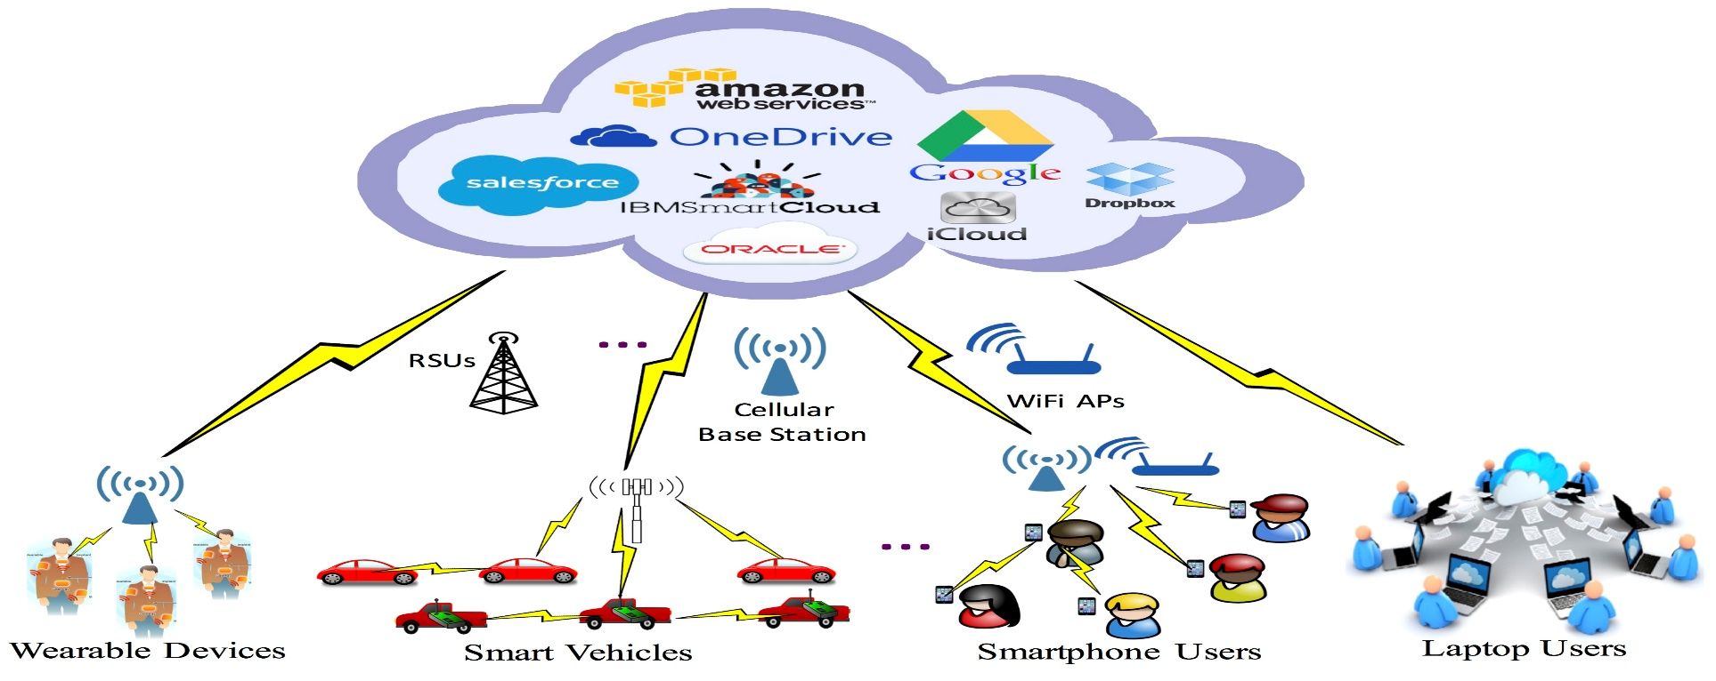
Cloud Computing
Azure is a Cloud Computing platform which provides the various services to meet our business goals.
What is Cloud Computing?
Cloud computing is the delivery of computing services over the internet. Computing services include common IT infrastructure such as virtual machines, storage, databases, and networking. Cloud services also expand the traditional IT offerings to include things like Internet of Things (IoT), machine learning (ML), and artificial intelligence (AI).

Slide 4
Infrastructure as a service (IaaS)
Cloud provides 3 different types of the services:
Infrastructure as a service (IaaS).
Platform as a service (PaaS).
Software as a service (SaaS).
Infrastructure as a Service: In an IaaS model, the cloud provider is responsible for maintaining the hardware, network connectivity (to the internet), and physical security. We are responsible for everything else: operating system installation, configuration, and maintenance; network configuration; database and storage configuration; and so on. With IaaS, we are essentially renting the hardware in a cloud datacenter.
Examples: Virtual machine, Virtual machine scale sets.
Use cases: Lift-and-shift migration, Testing and development.
Note: Region, Azure Zone, Region Pairing.
Link: Exercise - Create an Azure virtual machine - Training | Microsoft Learn

Slide 5
Platform as a service (PaaS)
Platform as a service (PaaS) is a middle ground between renting space in a datacenter (infrastructure as a service) and paying for a complete and deployed solution (software as a service). In a PaaS environment, the cloud provider maintains the physical infrastructure, physical security, and connection to the internet. They also maintain the operating systems, middleware, development tools, and business intelligence services that make up a cloud solution. In a PaaS scenario, we don't have to worry about the licensing or patching for operating systems and databases.
PaaS is well suited to provide a complete development environment without the headache of maintaining all the development infrastructure.
Example: App Service, Containers, AKS etc.
Use cases: Development framework:, Analytics or business intelligence.

Slide 6
Software as a service (PaaS)
Software as a Service: Software as a service (SaaS) is the most complete cloud service model from a product perspective. With SaaS, We are essentially renting or using a fully developed application. Email, financial software, messaging applications, and connectivity software are all common examples of a SaaS implementation.
While the SaaS model may be the least flexible, it’s also the easiest to get up and running. It requires the least amount of technical knowledge or expertise to fully employ.
Use cases: Email and messaging, Business productivity applications, Finance and expense tracking.

Slide 7
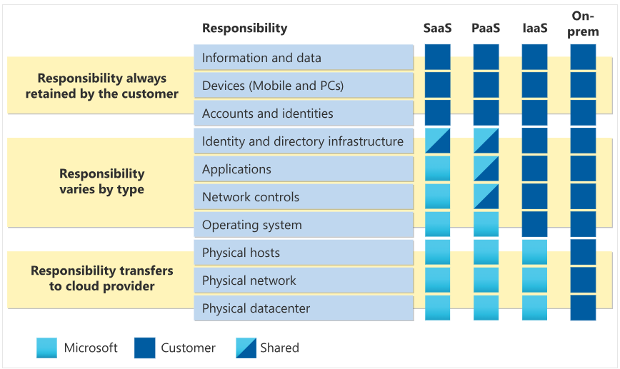
Shared Responsibility Model
Shared responsibility model:

Slide 8
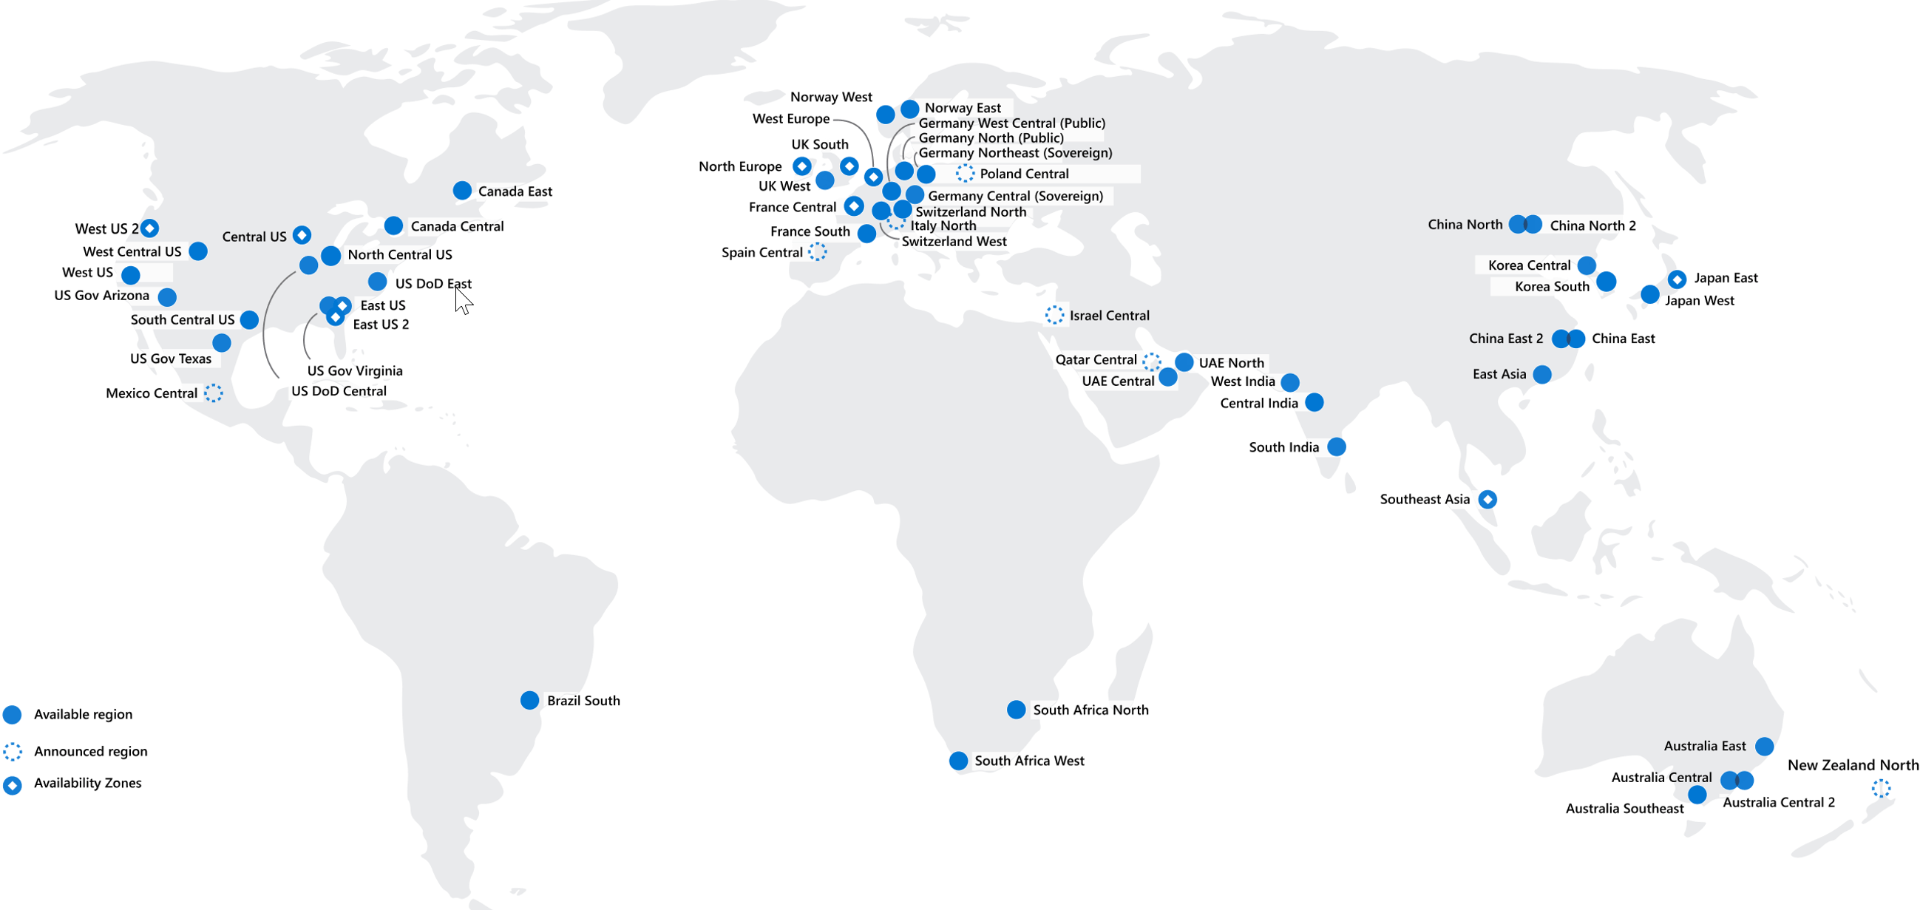
Azure Regions

Slide 9
Cloud Models
The cloud models define the deployment type of cloud resources. The three main cloud models are: private, public, and hybrid.
Private cloud: A private cloud is, in some ways, the natural evolution from a corporate datacenter. It’s a cloud (delivering IT services over the internet) that’s used by a single entity. Private cloud provides much greater control for the company and its IT department. However, it also comes with greater cost and fewer of the benefits of a public cloud deployment. Finally, a private cloud may be hosted from your on site datacenter. It may also be hosted in a dedicated datacenter offsite, potentially even by a third party that has dedicated that datacenter to your company.
Public cloud: A public cloud is built, controlled, and maintained by a third-party cloud provider. With a public cloud, anyone that wants to purchase cloud services can access and use resources. The general public availability is a key difference between public and private clouds.

Slide 10
Continued..
Multi-cloud: A fourth, and increasingly likely scenario is a multi-cloud scenario. In a multi-cloud scenario, you use multiple public cloud providers. Maybe you use different features from different cloud providers. Or maybe you started your cloud journey with one provider and are in the process of migrating to a different provider. Regardless, in a multi-cloud environment you deal with two (or more) public cloud providers and manage resources and security in both environments.
Community Model: “A shared cloud computing service environment that is targeted to a limited set of organizations or employees(such as banks or heads of trading firms)”.
Organizations from a single community usually have similar cloud requirements regarding security and compliance, compute resources and applications. A community integrates the features and benefits of multiple cloud type into a single solution tailored for a particular industry. It is also suitable for organizations working on a common project, research topic, or application and accessing similar resources. A community cloud allows such organizations to communicate, share and collaborate without relying on public cloud.

Slide 11
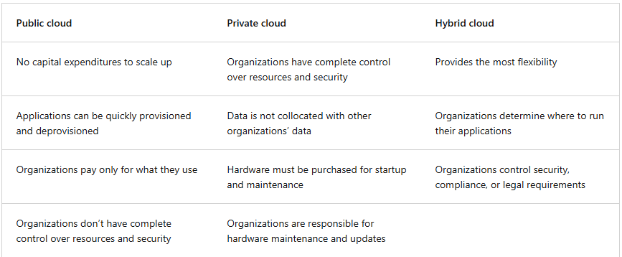
Cloud Models
Cloud Models Differences:

Slide 12
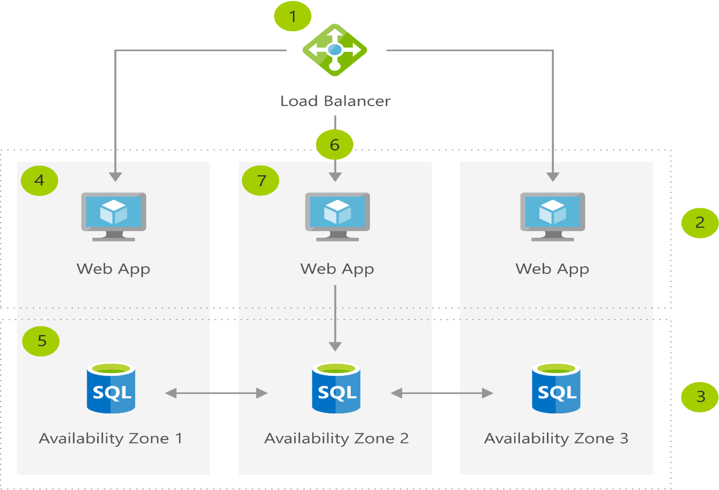
Benefits of Cloud Services
High Availability: High availability focuses on ensuring maximum availability, regardless of disruptions or events that may occur.
Azure is a highly available cloud environment with uptime guarantees depending on the service. These guarantees are part of the service-level agreements (SLAs).

Slide 13
Benefits of Cloud Services
2. Scalability: Scalability refers to the ability to adjust resources to meet demand. If you suddenly experience peak traffic and your systems are overwhelmed, the ability to scale means you can add more resources to better handle the increased demand.
Scaling generally comes in two varieties: vertical and horizontal.
Vertical scaling: When we are developing an app and if we needed more processing power, we could vertically scale up to add more CPUs or RAM to the virtual machine. Conversely, if we realized you had over-specified the needs, you could vertically scale down by lowering the CPU or RAM specifications.
Horizontal scaling: When we suddenly experienced a steep jump in demand, our deployed resources could be scaled out (either automatically or manually). For example, we could add additional virtual machines or containers, scaling out. In the same manner, if there was a significant drop in demand, deployed resources could be scaled in (either automatically or manually), scaling in.

Slide 14
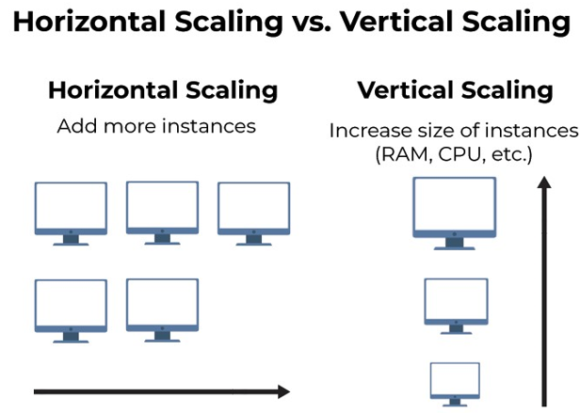
Continued..
Scaling:

Slide 15
Continued..
3. Reliability: Reliability is the ability of a system to recover from failures and continue to function.
The cloud, by virtue of its decentralized design, naturally supports a reliable and resilient infrastructure. With a decentralized design, the cloud enables us to have resources deployed in regions around the world. With this global scale, even if one region has a catastrophic event other regions are still up and running. We can design our applications to automatically take advantage of this increased reliability.
4. Predictability: Predictability can be focused on performance predictability or cost predictability. Both performance and cost predictability are heavily influenced by the Microsoft Azure Well-Architected Framework. Deploy a solution that’s built around this framework and we have a solution whose cost and performance are predictable.
Autoscaling, load balancing, and high availability are just some of the cloud computing concepts that support performance predictability.
Total cost of Ownership(TCO) or Pricing Calculator to get an estimate of potential cloud spend.
5. Agility: We can deploy and configure cloud-based resources quickly as app requirements change.

Slide 16
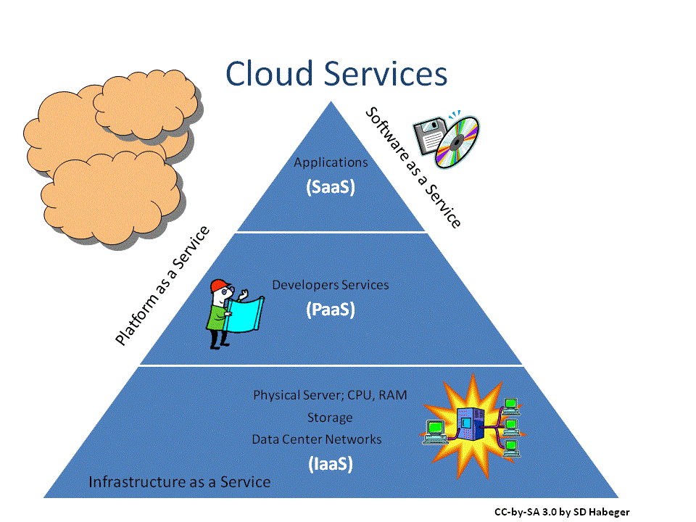
Continued..

Slide 17
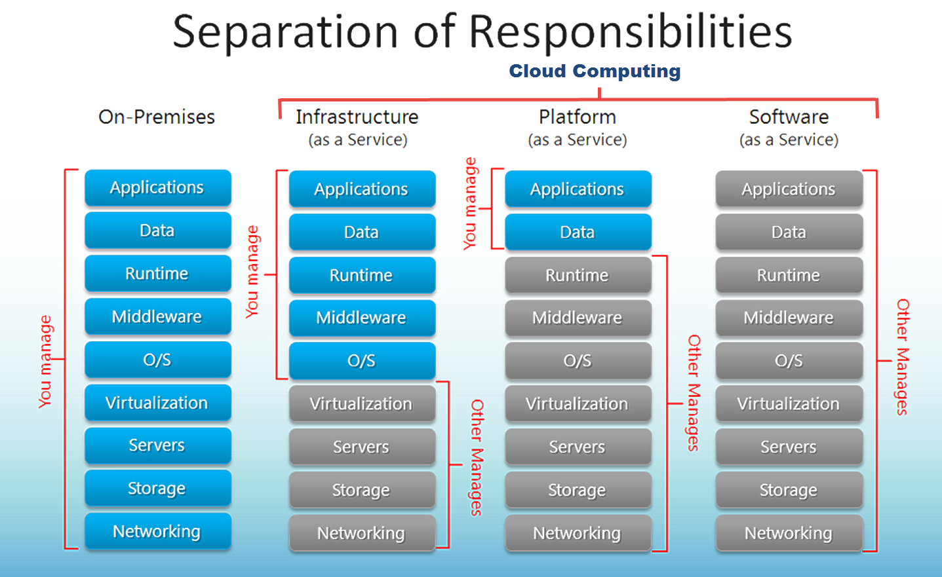
Continued..

Slide 18
Consumption Based Model
There are two types of expenses to consider. Capital expenditure (CapEx) and operational expenditure (OpEx).
CapEx is typically a one-time, up-front expenditure to purchase or secure tangible resources. A new building, repaving the parking lot, building a datacenter, or buying a company vehicle are examples of CapEx.
OpEx is spending money on services or products over time. Renting a convention center, leasing a company vehicle, or signing up for cloud services are all examples of OpEx.
Cloud computing falls under OpEx because cloud computing operates on a consumption-based model. With cloud computing, we don’t pay for the physical infrastructure, the electricity, the security, or anything else associated with maintaining a datacenter. Instead, we pay for the IT resources we use. If we don’t use any IT resources this month, you don’t pay for any IT resources.
This consumption-based model has many benefits, including:
No upfront costs.
No need to purchase and manage costly infrastructure that users might not use to its fullest potential.
The ability to pay for more resources when they're needed.
The ability to stop paying for resources that are no longer needed.

Slide 19
Assignment
Activate an Azure Sandbox.
Link: Exercise - Create an Azure virtual machine - Training | Microsoft Learn
Azure Virtual Machine by Activating the Sandbox.

Slide 20
Thanks

